Slide 1
NPCI API Accelerator Hackathon
Topic:
Intelligent Complaint Management System
Team: sid3345
Team Members:
Siddharth Sinha, (sid3345@gmail.com)
Prashanth Reddy (mprashanth059@gmail.com)

Slide 2
Challenges
Inflexible, Outdated Systems.
Fragmented and Insufficient Information.
Lack of integrated and intelligent system, to gather insights.
Lack of Analytics.
No use of modern, cutting edge tools / technologies (NLP, predictive analytics, visualisations etc).
Readymade softwares are expensive and less customised (eg: Tableau).

Slide 3
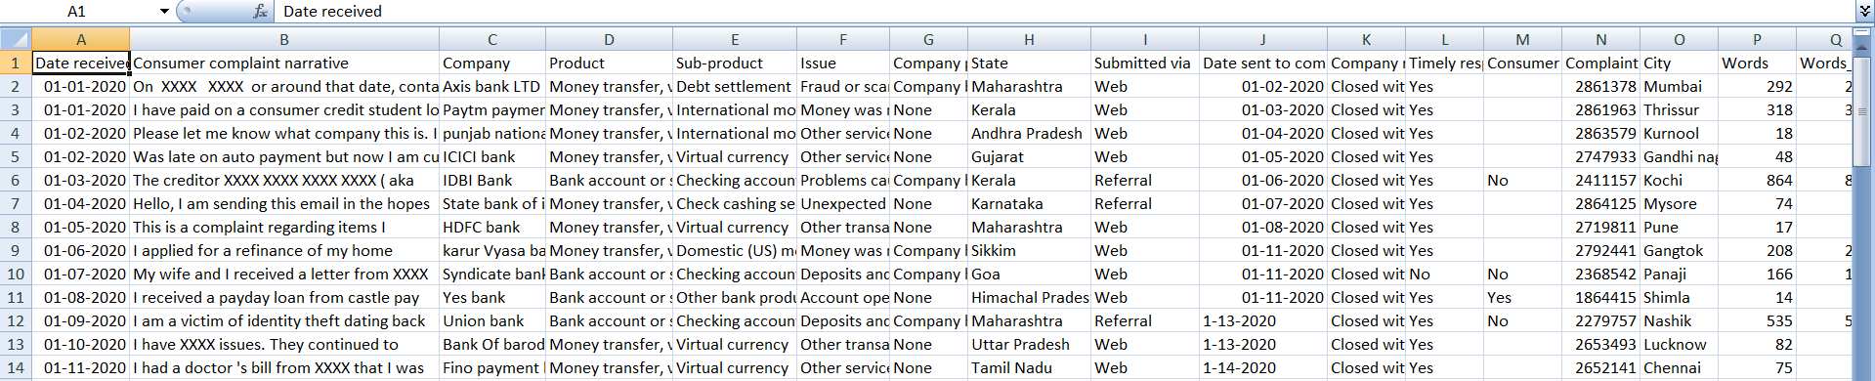
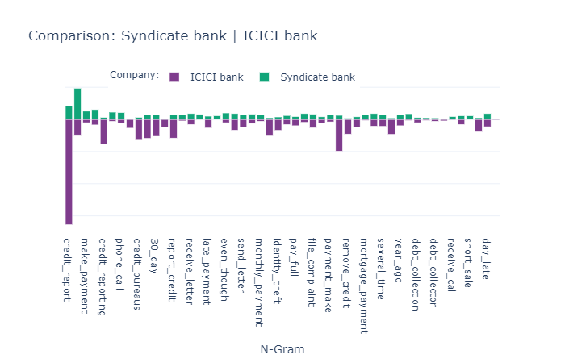
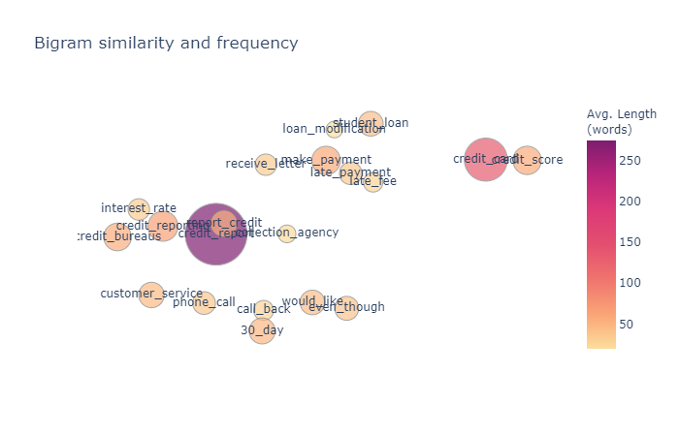
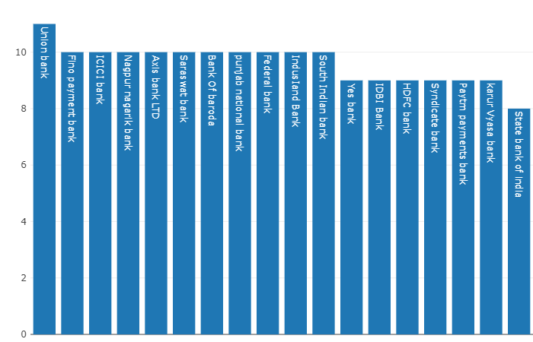
Features
Dataset: Live complaints through API
or dynamic database
(currently fabricated data used for prototype)
Bigram model used to understand
semantics of complaint texts
and analyse its topic.
Bar plot to understand average count of complaints per bank, changeable according
to time frame selected.

Slide 4
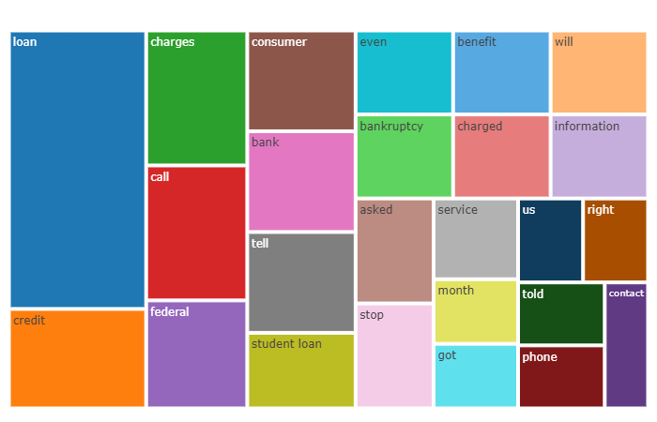
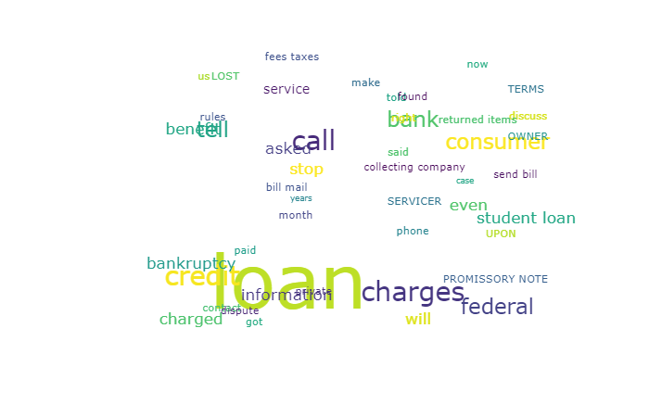
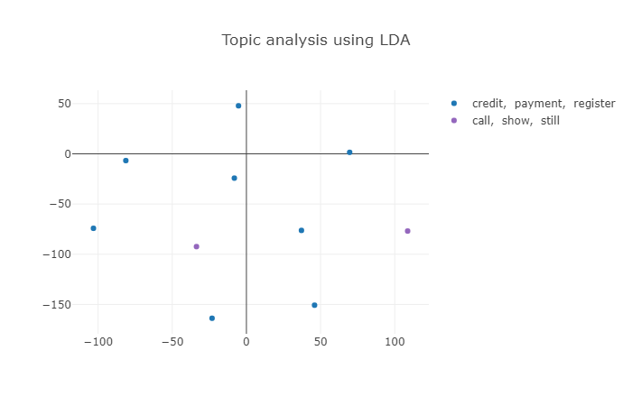
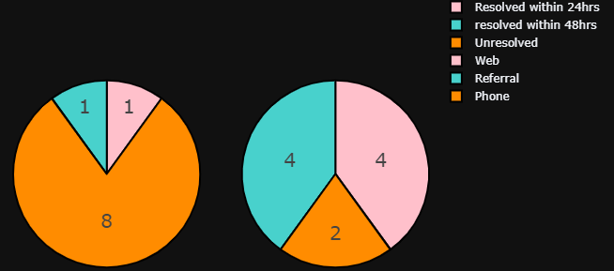
Obtain most frequently used words
in complaints of a particular bank,
using tree map
and word cloud.
Topic modelling using LDA.
Pie charts for complaint resolution time frame (24, 48 hrs) and by their medium of submission (web, phone, fax, etc).

Slide 5
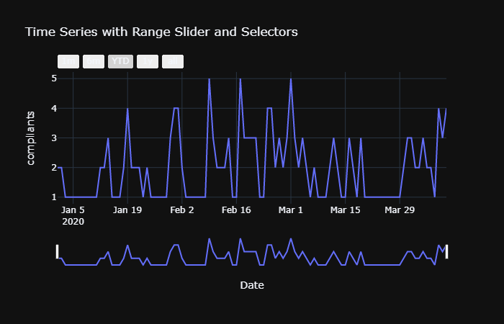
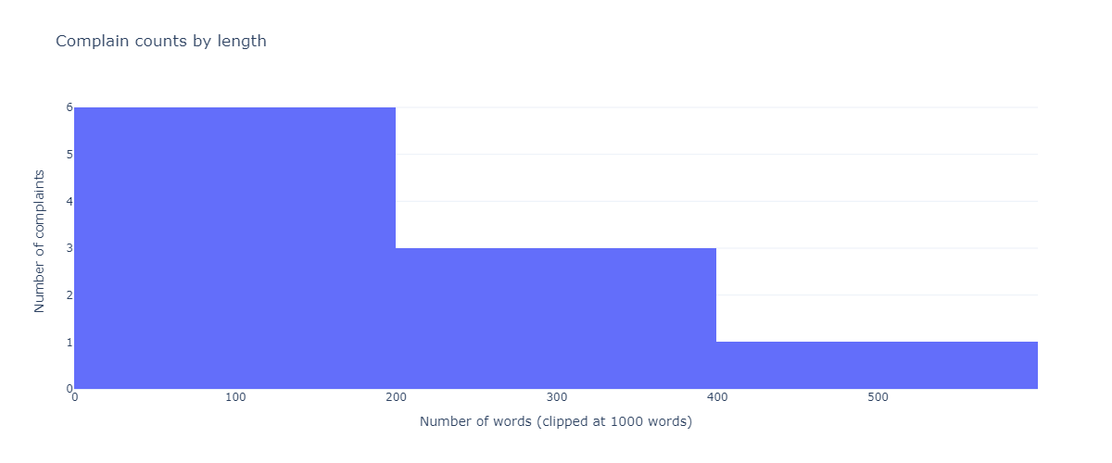
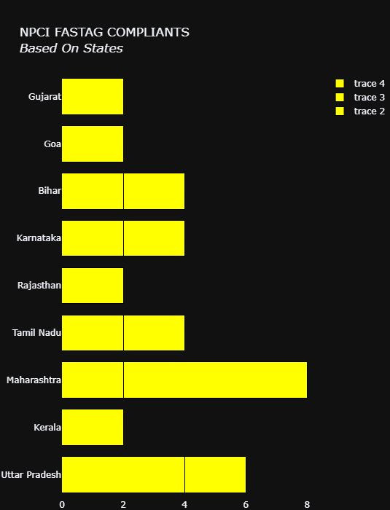
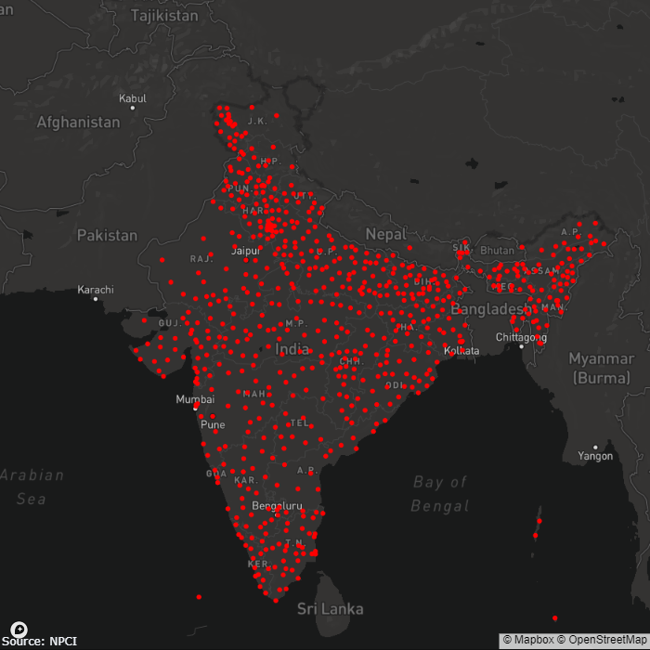
Time series visualisation for analysing hourly, daily and monthly number of complaints.
Visualization for average length of complaints, for a particular bank.
Bar plot for state wise
count of complaints.
City wise map complaint
count bubble.

Slide 6
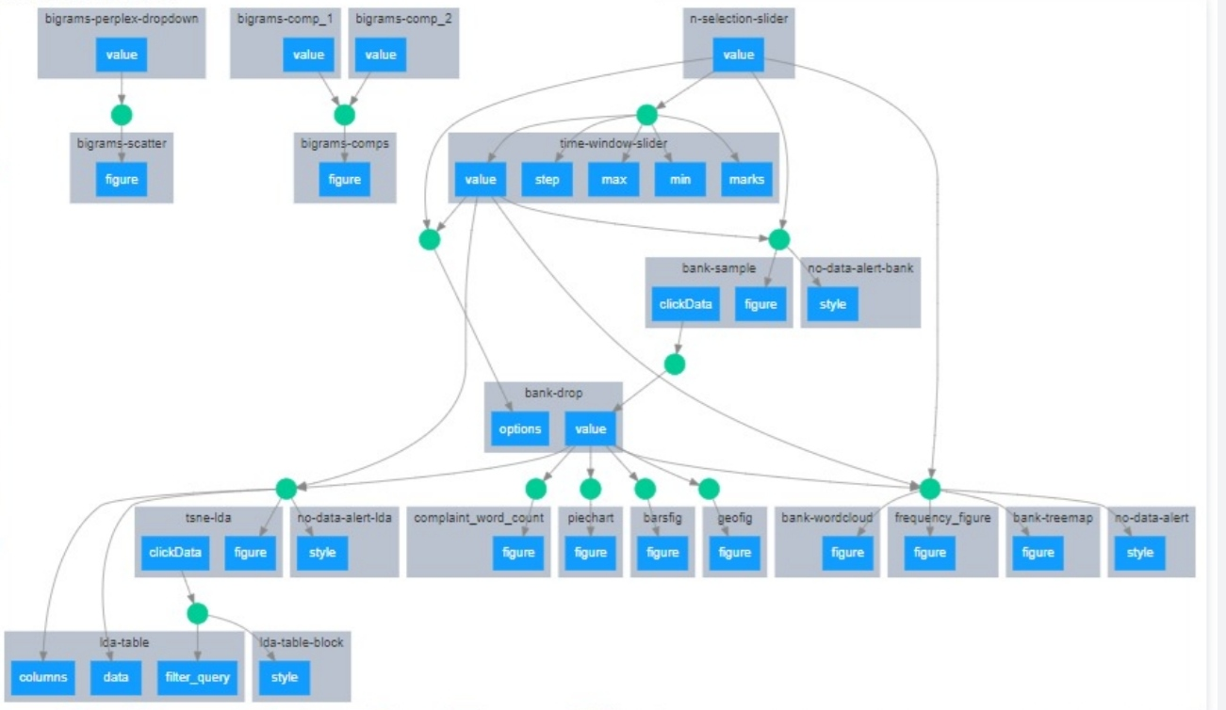
Flow Diagram

Slide 7
Advantages
Live, real time, dynamic dashboard with interactive visualisations.
Modifiable plots according to size, zoom, timeline, scale, points, legend, etc.
No Rest API’s, multiple technologies, complex JS libraries required (not even separate HTML, JS).
Single language: Python.
Light weight, not resource intensive, easy debugging.
Customizable according to data points available and business requirements
Can be easily hosted on cloud platforms.

Slide 8
Technology Stack
Python
Dash (Python library)
Plotly (dynamic visualisations)
NLTK (Python library for NLP)
Flask (web deployment)

Slide 9
Future Scope
Sentiment analysis on social media mentions (Twitter, etc.)
Predictive Analytics for future complaint forecast.
Extensive use of NLP and deep learning for word embeddings (Word2Vec, Glove).
Comparative trends.
Response time analysis.
Customer satisfaction measure.
Complaint resolution efficiency measure.

